Slide 1
Literacy Intervention
K Carlisle, LSKY School Division, September 2018

Slide 2

Begin with the…
“Why?”
Notes:
When we consider students that need extra supports and what those supports should be it is important to think about why the current system is not meeting their needs. As students become more and more diverse we need to adapt our structures and instructional strategies to accommodate a wider range of levels.
View video and fill out the 4Cs viewing sheet

Slide 3
The Myth of the Average
https://www.youtube.com/watch?v=4eBmyttcfU4
Notes:
When we consider students that need extra supports and what those supports should be it is important to think about:
Why the current system is not meeting their needs?
What can be do intervene when they are not meeting outcomes?
What can we change at the universal level?
Record your thoughts on the 4Cs sheet as you view the video.

Slide 4

Connections Concepts Challenges Changes
Notes:
Discuss connections, concepts, challenges and changes after viewing

Slide 5
What does literacy intervention look like at the high school level?
Notes:
Many kids with jagged learning profiles…
We need to create structures and implement instructional strategies …design to the edges.

Slide 6
Pedagogy, Andragogy and Heutagogy
Compare the principles of learning
What is the connection to high school level intervention?
Notes:
Handout
Think pair share: What is different between pedagogy, androgogy and heutagogy?
Pedagogy is more teacher centered, whereas the adult learning principles are more learner centered and based on the learner’s needs and experiences.
Many now believe that there is really no basis for distinguishing between child and adult learning and the adult practices are good practices across all ages. Self directed learning is our ultimate goal. If we incorporate the principles of self-directed learning intervention with young adults is likely to be more successful and effective.

Slide 7
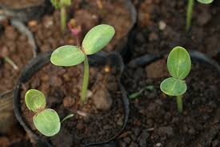
Self-directed learning: Growth mindset
Learning that is:
Personalized
Goal oriented
Notes:
How does this connect to growth mindset? - Self directed learners have a growth mindset and believe they will succeed.
We now know that cognitive ability is not fixed and that intelligence can be developed. Kids get smarter by talking, reading and writing in meaningful ways. They need to know this. Brain research supports personalized learning that is self-directed and goal oriented.
How does this apply to intervention at the high school level? Growth mindset research supports students being involved in goal setting and individualized personalized learning plans.
When students are involved in setting their own goals and believe they can succeed learning is enhanced.

Slide 8
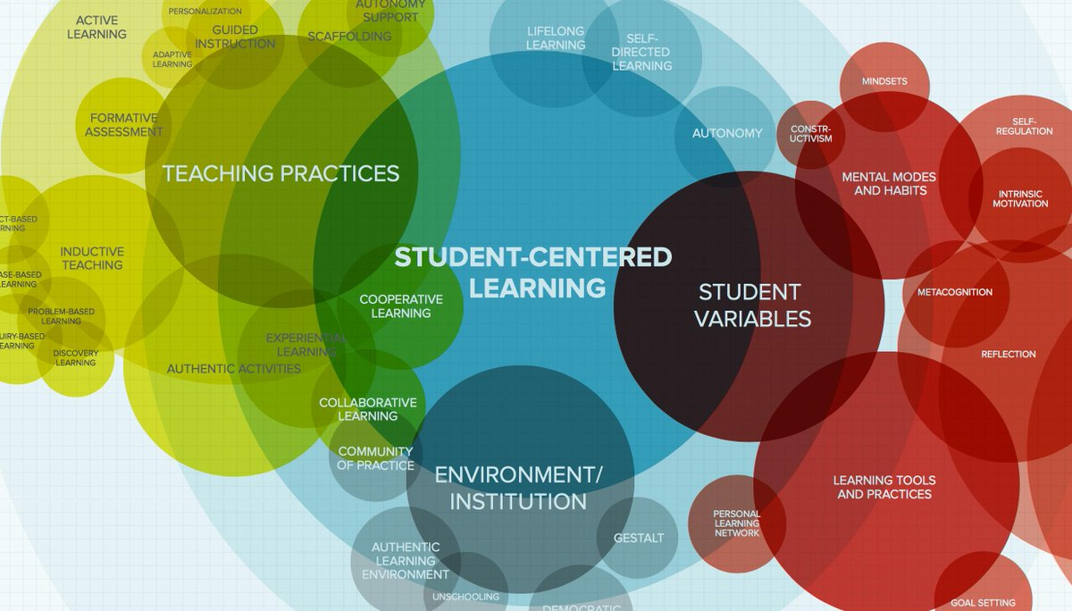
Begin with the students
Establishing learning goals
Individual or small group instruction
Conferencing: Strength-based formative assessment
Notes:
Learner inventory
Questions every student should be able to answer: www.teachthought.com
Quote from the website: The importance of integrating questioning in your teaching pedagogy is twofold: first it provides students with an outlet to vociferate their voice and actively participate in the formulation of their learning needs. It also enables them to engage in self-reflection and meta-thinking which are two processes pivotal for students’ cognitive growth. Second, answers students provide are a gold mine of raw feedback teachers can work on to understand students learning needs, their learning expectations, and most importantly their inner worlds. Such a knowledge could be employed in designing teaching materials and content that respond to student’s needs.
Reading and Writing goals

Slide 9

Structures
…
Reading / Writing Workshop
Conferencing
Small group instruction
Notes:
Remember that reading and writing are intertwined. Whatever you do to enhance writing with improve reading and vice versa

Slide 10
Structures
…
Book clubs
Classroom libraries
Flexible comfortable learning environment
Notes:
Remember that reading and writing are intertwined. Whatever you do to enhance writing with improve reading and vice versa

Slide 11



Structures
180 Days, Penny Kittle & Kelly Gallagher, 2018
***Workshop model

Slide 12

Designing Personalized Instruction
Supporting jagged learning profiles!

Slide 13
Resources - Reading
Focus on unit of study, self-selected book, or a research topic
Visible thinking routines: http://www.visiblethinkingpz.org
Classroom strategies (Before, During and After reading) Adolescent Literacy website: http://www.adlit.org/strategy_library/

Slide 14
Resources - Reading
Reading instruction mini lessons:
The Reading Strategies Book, Jennifer Serravallo. One-page lesson summaries on lsky curriculum connections: https://www.lskysd.ca/ProgramsLearning/CurriculumAndInstruction/StrategicPlan/Literacy/Reading/Guided/Pages/default.aspx
Habits of Mind reading comprehension: lsky curriculum connections link above

Slide 15
Resources: Writing
Focus on a piece of writing student would like to “publish” or begin with Quick Writing activities to build fluency.
Quick writes from spoken word poetry video prompts on Penny Kittle’s website: http://pennykittle.net/index.php?page=spoken-word-poetry-videos
Mentor texts and passages also on website
Quick Writes for inside writing (Kittle and Graves)

Slide 16
Resources: Writing
Tune in to Learning Video / writing resources: http://www.tv411.org/writing
Writing strategy lessons:
Jennifer Serravallo, The Writing Strategies Book, 2017
Writing assessment:
Serravallo Look fors: Informational, opinion and personal memoir writing:
https://www.lskysd.ca/ProgramsLearning/CurriculumAndInstruction/StrategicPlan/Literacy/Writing/Guided/Pages/default.aspx

